Slide 1
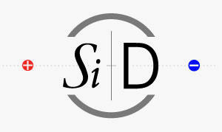

Ecal Resolution Studies and update
Jason Barkeloo
J. Brau, A. Steinhebel, E. Meyer, J. Carlson
University of Oregon
ALCW 2018
June 1, 2018

Slide 2
Outline
KPiX
Reminder of What Has Been Done
Where I started on the project
Test Beam Simulation and Comparison to KPiX data
How we start applying these to the full detector model
Current Geometry Studies
Effects on Resolution
Beginning to Look at Simulated Events

Slide 3
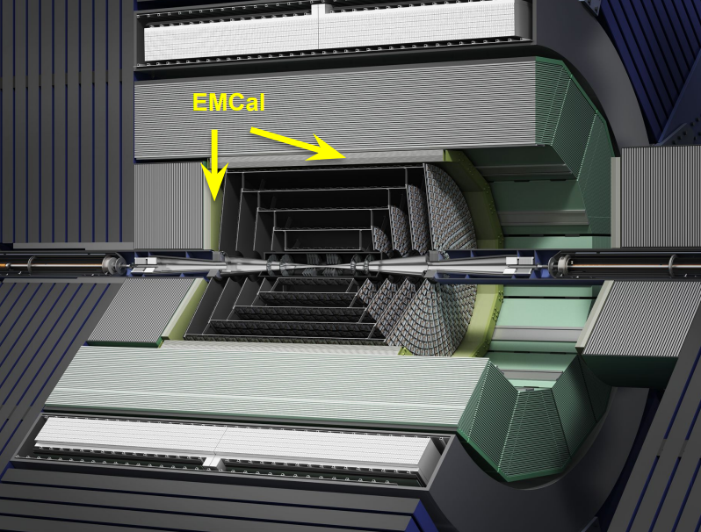
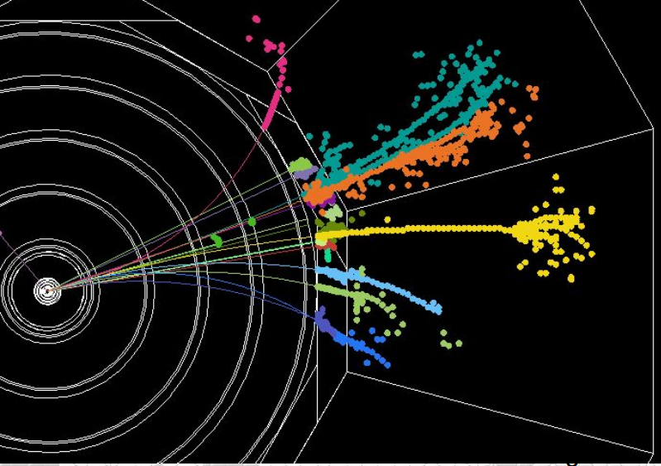
Particle flow Calorimetry
SiD has been designed to use Particle Flow Calorimetry to measure all final states with precision
We expect excellent jet energy resolution
Measure charged momenta with tracker, neutral energies with calorimeters
Requires very fine segmentation
An “Imaging ECAL” is a crucial part of the design
Silicon-Tungsten based calorimeter is being developed for a high granularity ECAL
KPiX ASIC for readout of silicon pixels

Slide 4
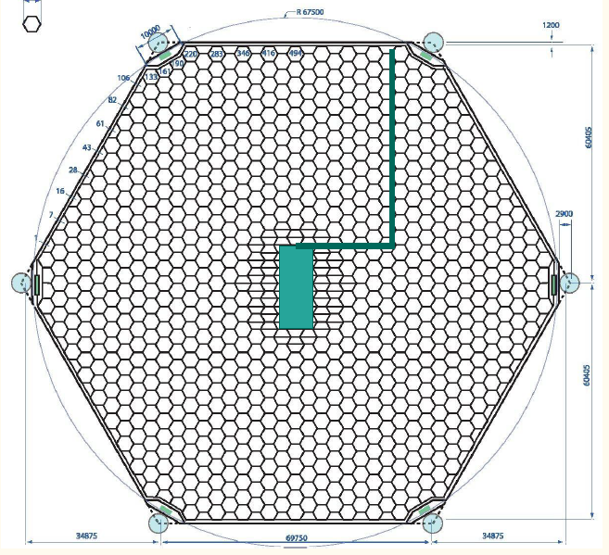
kpix
6 inch wafers
1024 13mm² pixels
Readout and cable are bump-bonded directly to the sensor
Test beam studies have happened with an initial version of this KPiX sensor design
Will come back to the geometry and its effect on resolution measurements

Slide 5
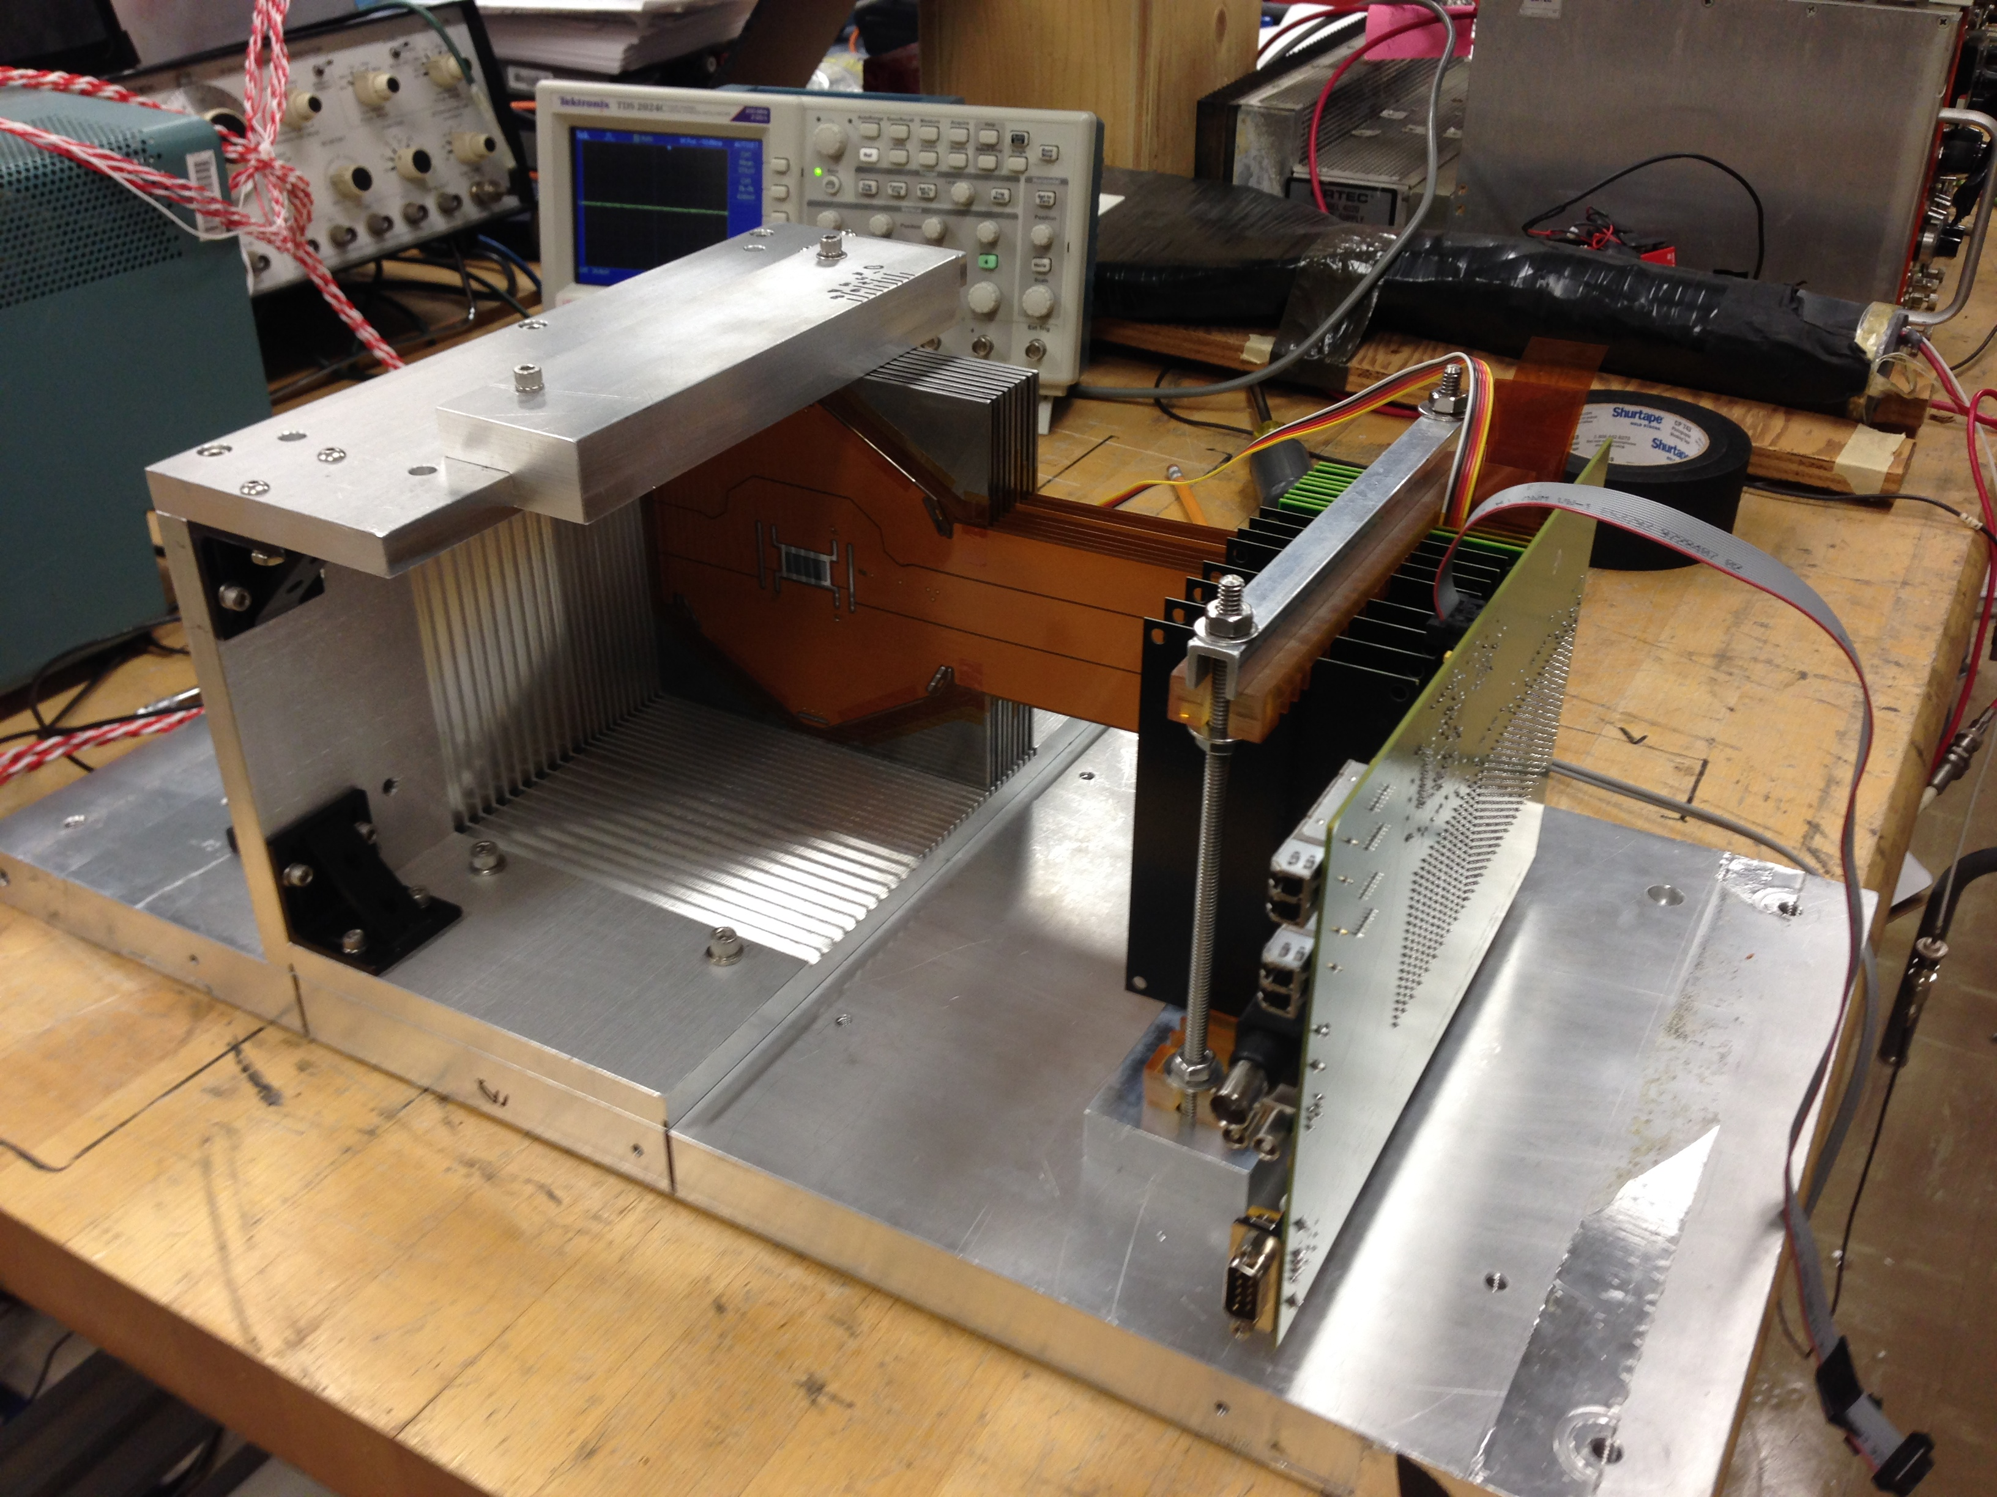
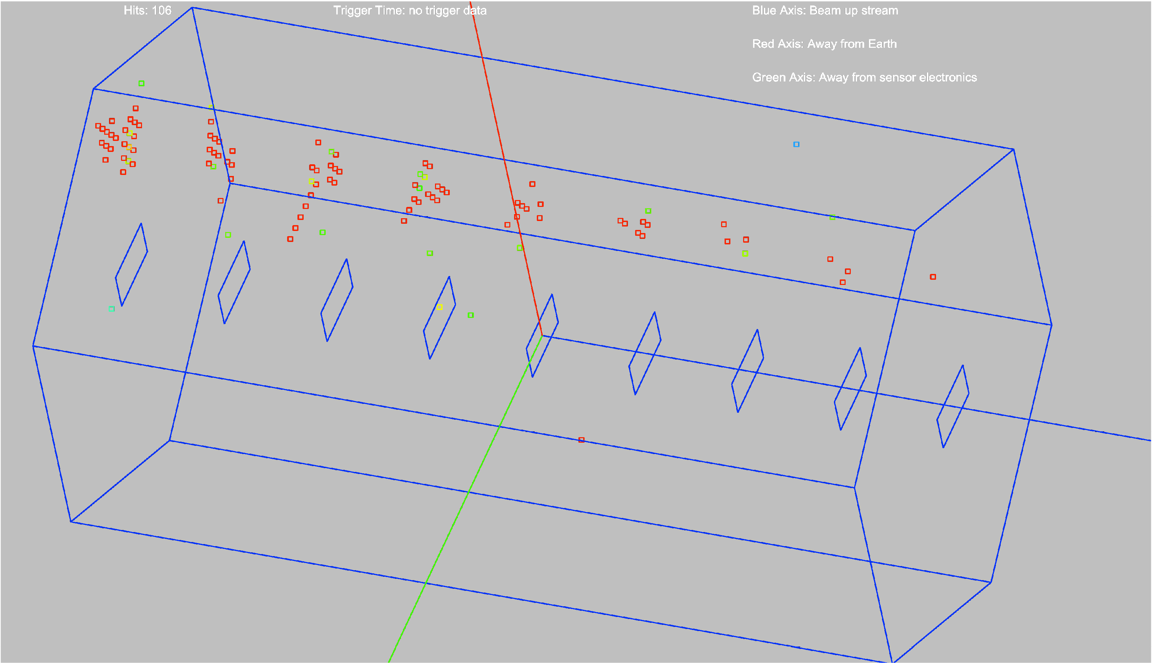
Test beam studies
Small 9 layer stack was placed into SLAC test beam
Sensor issues have been found and change the design going forward
Cross Talk, Dead Pixels, …
Many electron events were seen that we can analyze and compare with simulation to improve understanding of the system
Resolution, Identification (how well we can tell how many electrons are in an event)

Slide 6
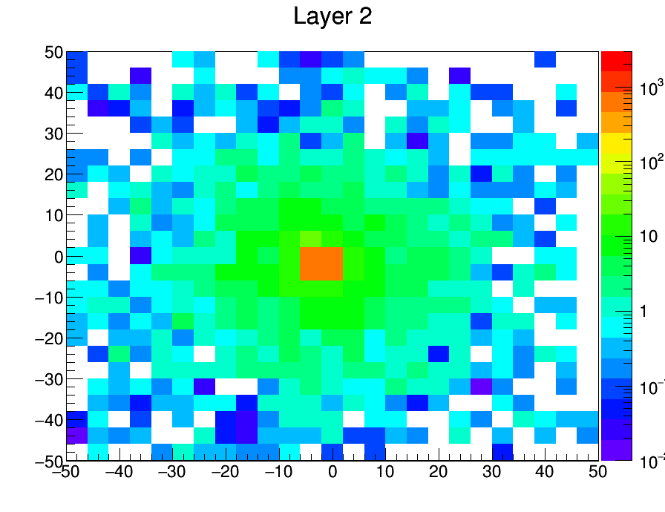
Geant4 Simulation created of 40x40cm plane of alternating Si (320 μm) and W (2.5mm,5/7 χ₀ )
40 (thin W) layer detector simulated simulated, only include 9 to match test beam stack for comparisons sake
Electrons fired at origin of various energies (in particular 12.1 GeV, test beam energy)
Want to try to match test beam running conditions
1000events, 10GeV. Energy in MeV deposited (all events summed) on the z-axis.

Slide 7
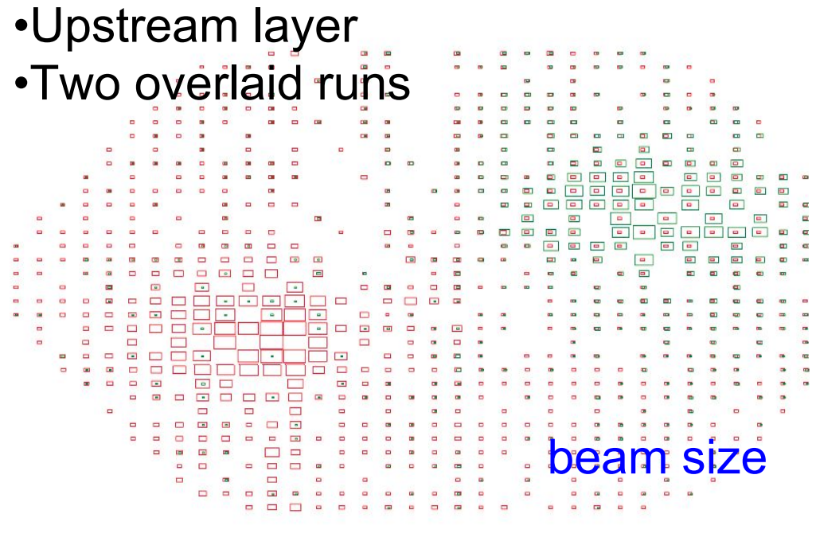
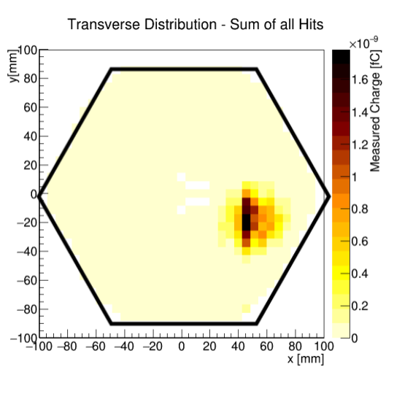
Comparisons (cont.)
Attempted to model distribution of electron multiplicity and errors in test beam
10% pixels randomly removed from each layer
Poisson distribution of simultaneous electrons per event used <n>=0.8725
Shifted from central area (more densely pixelated, also test beam was shifted away)
Match hit to KPiX pixel location

Slide 8
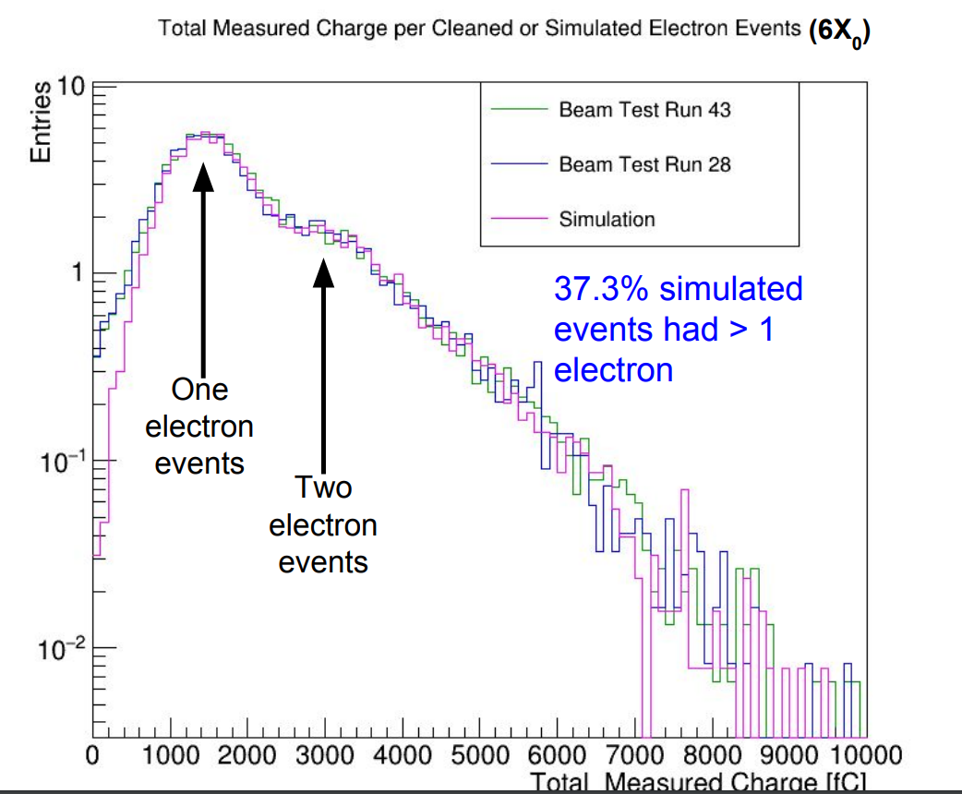
Comparisons (cont.)
Excellent agreement to test beam data.
Couldn’t remove all of the low E shoulder during test beam cleaning (lots of ~0fC hits)

Slide 9
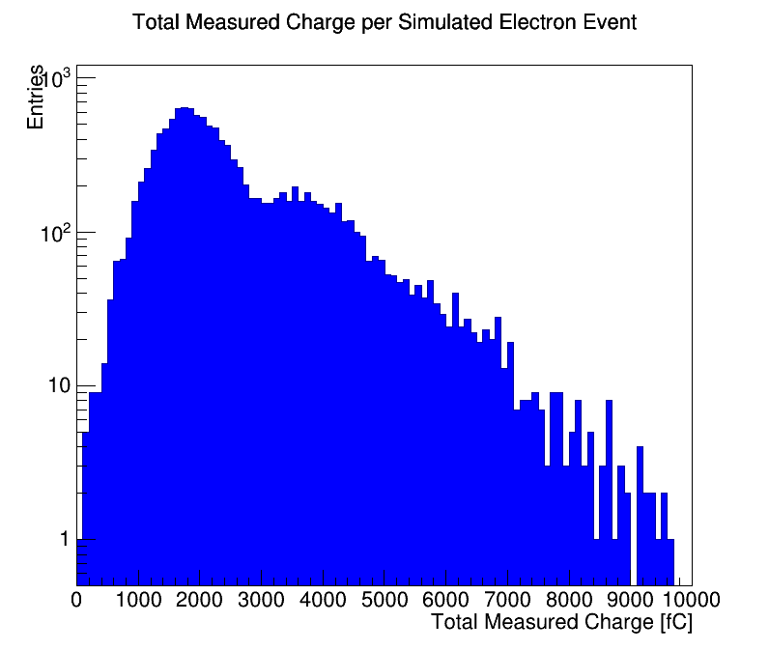
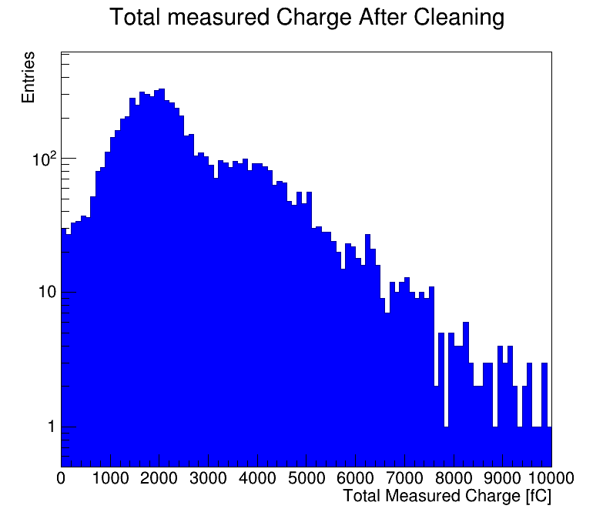
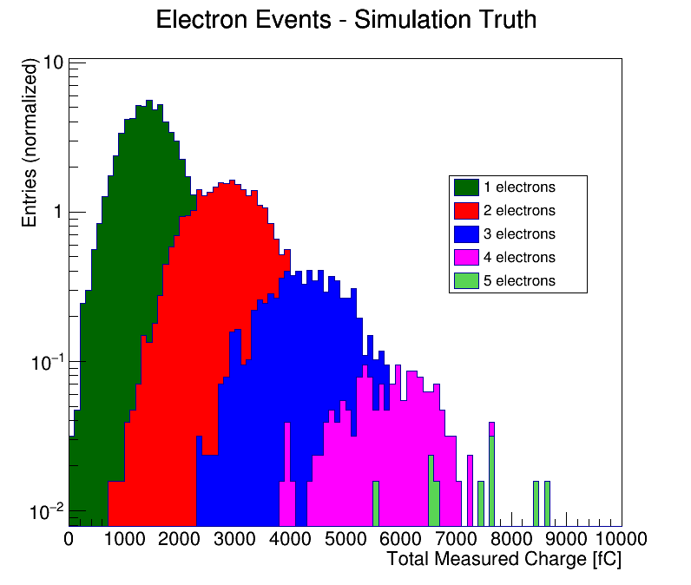
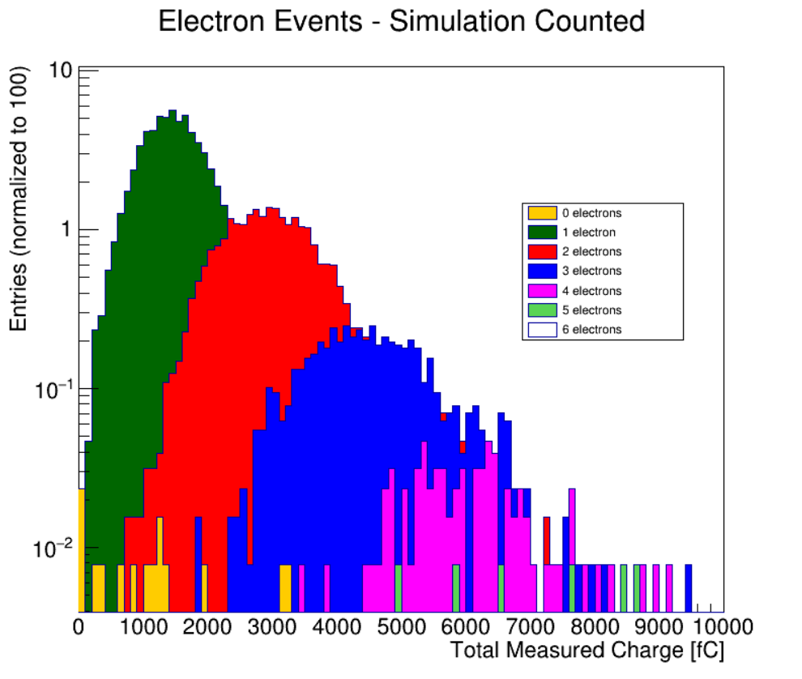
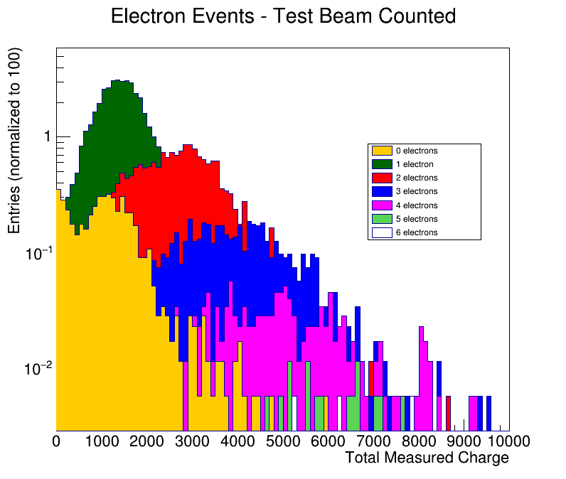
Counting Electrons
Algorithm used to count the number of electrons in the even based on energy distributions throughout the detector.

Slide 10
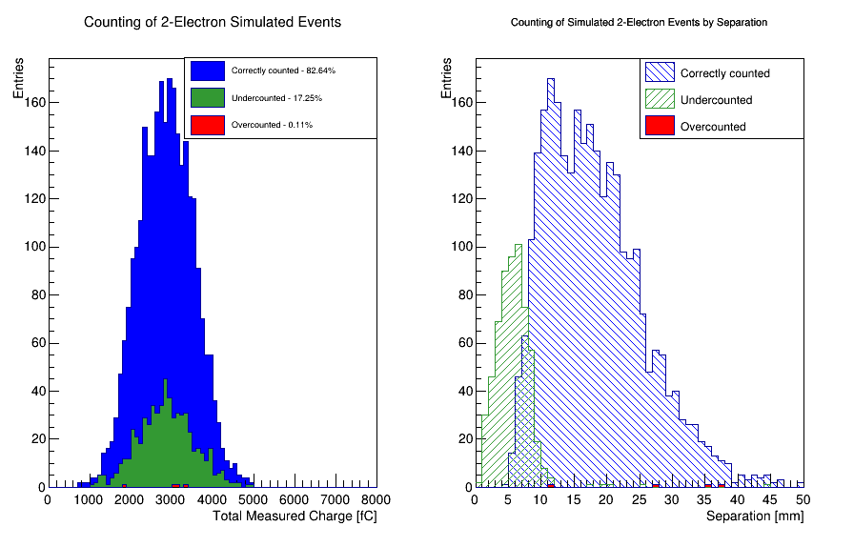
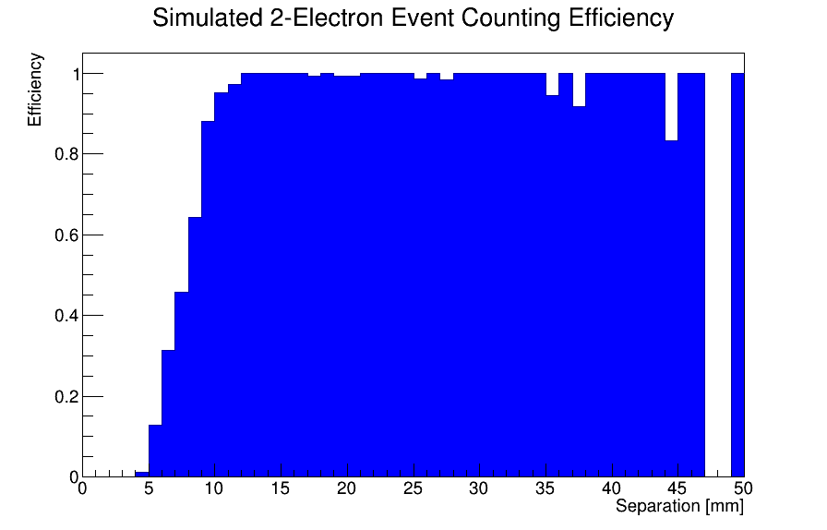
Counting Electrons (Cont.)
No field, just simple detector simulation

Slide 11
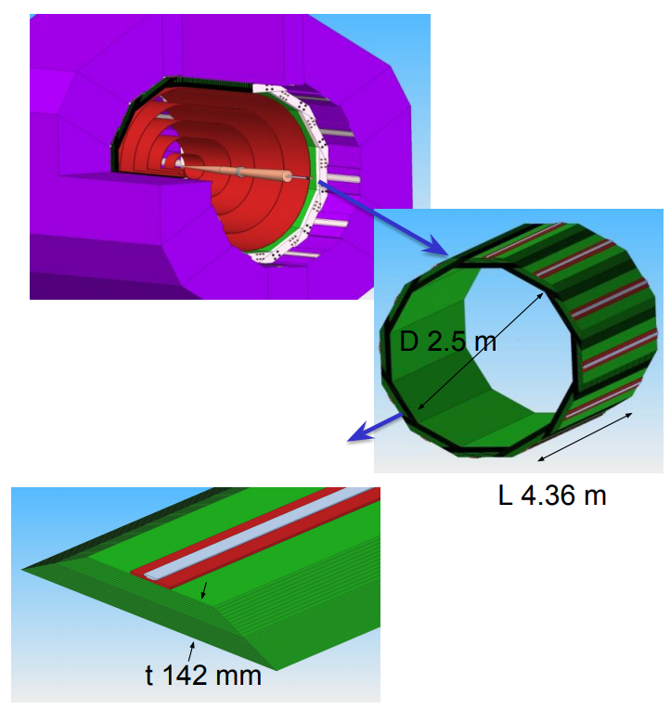
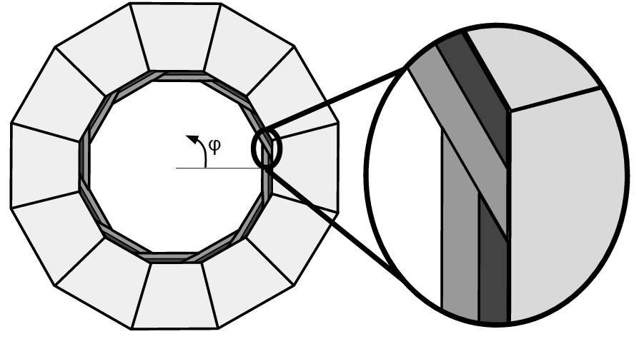
ECAL Geometry And its Effects
20 layers 2.5mm W
10 layers 5mm W
30 gaps 1.25mm w/pixel sensors
29 χ ₀

Slide 12
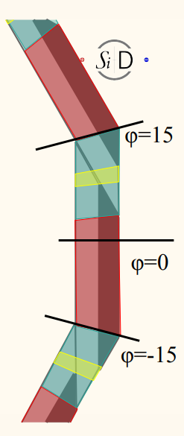
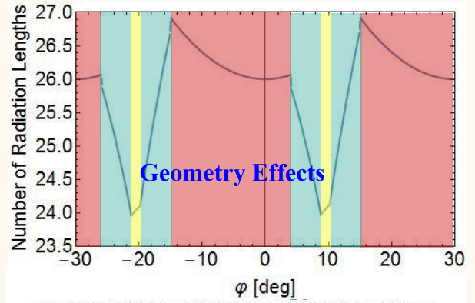
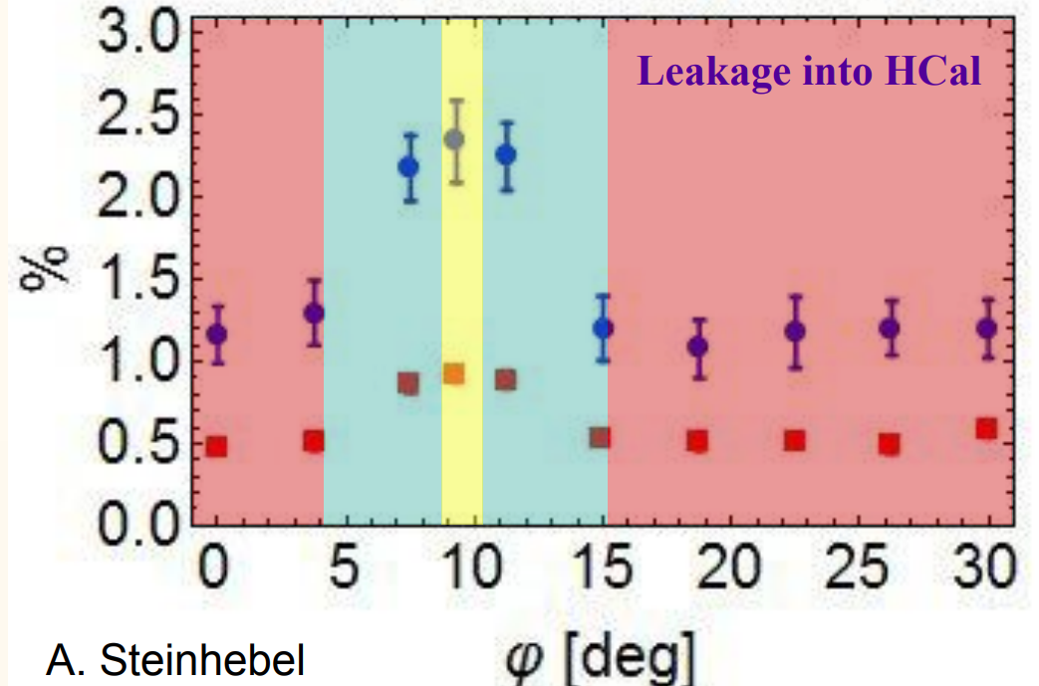
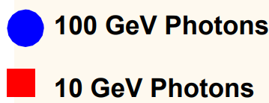
Geometry Effects
Leakage into HCAL in overlap region increases due to less material, phi dependent

Slide 13
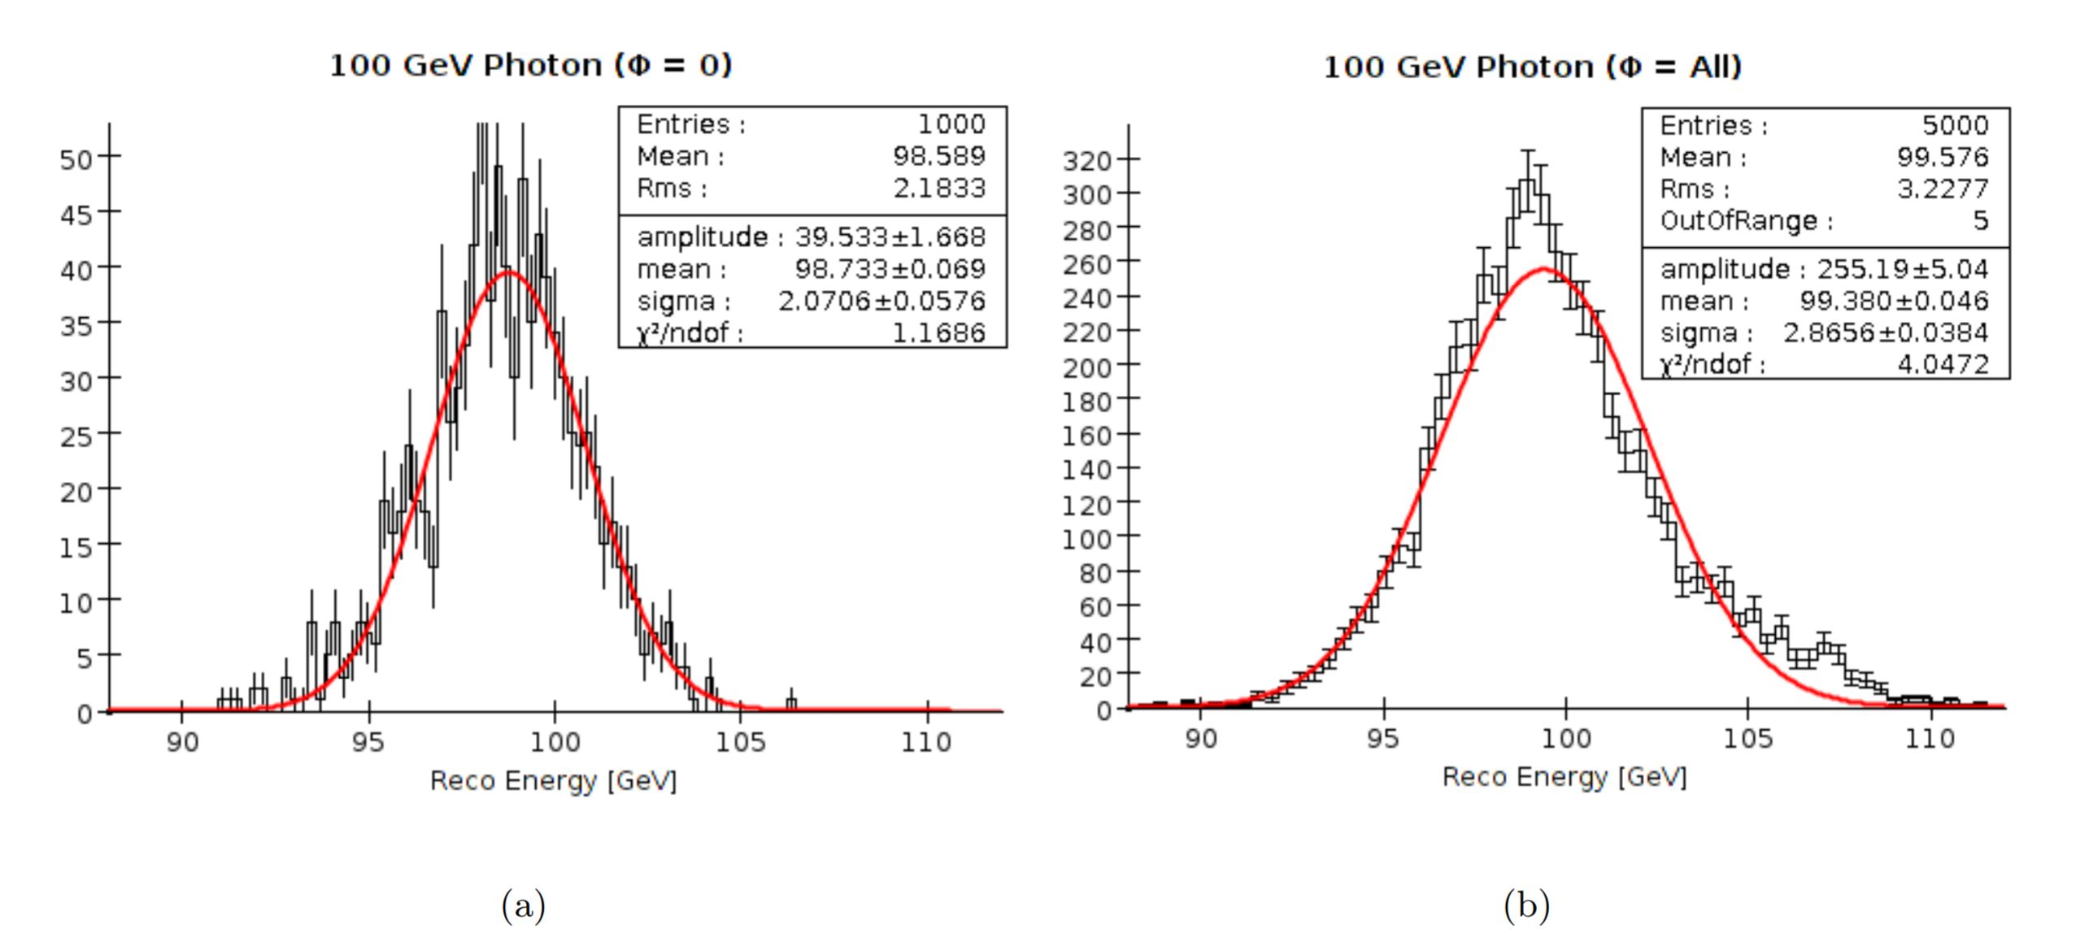
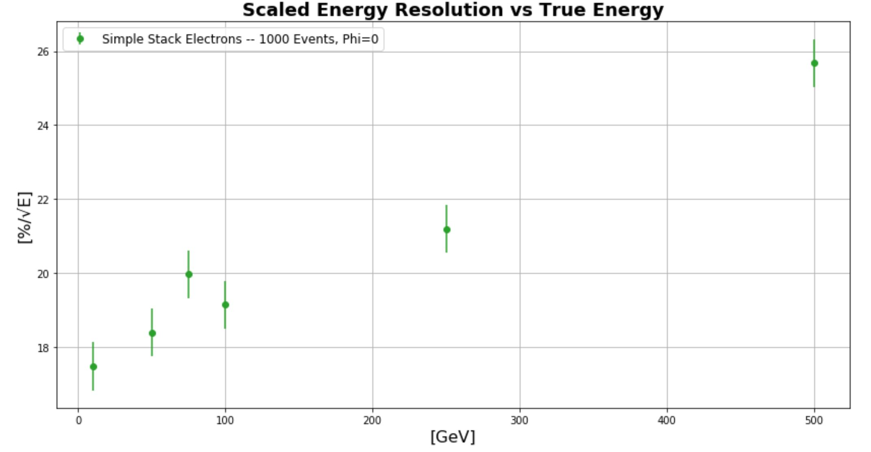
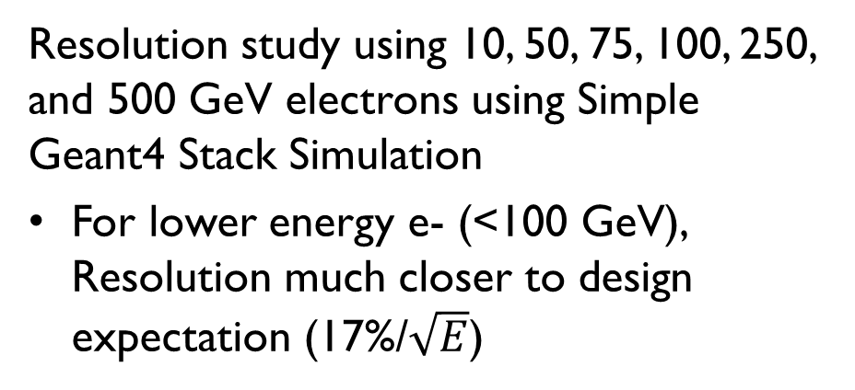
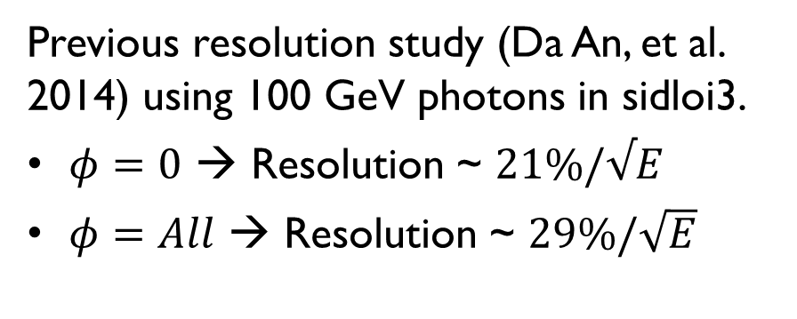
Resolution Effects from geometry
Previous resolution study (Da An, et al. 2014) using 100 GeV photons in sidloi3.
$φ=0$ → Resolution ~ $21\%/√E$
$φ=All$ → Resolution ~ $29\%/\sqrt{E}$
Resolution study using 10, 50, 75, 100, 250, and 500 GeV electrons using Simple Geant4 Stack Simulation
For lower energy e- (<100 GeV), Resolution much closer to design expectation (17%/$\sqrt{E}$)
E. Meyer

Slide 14
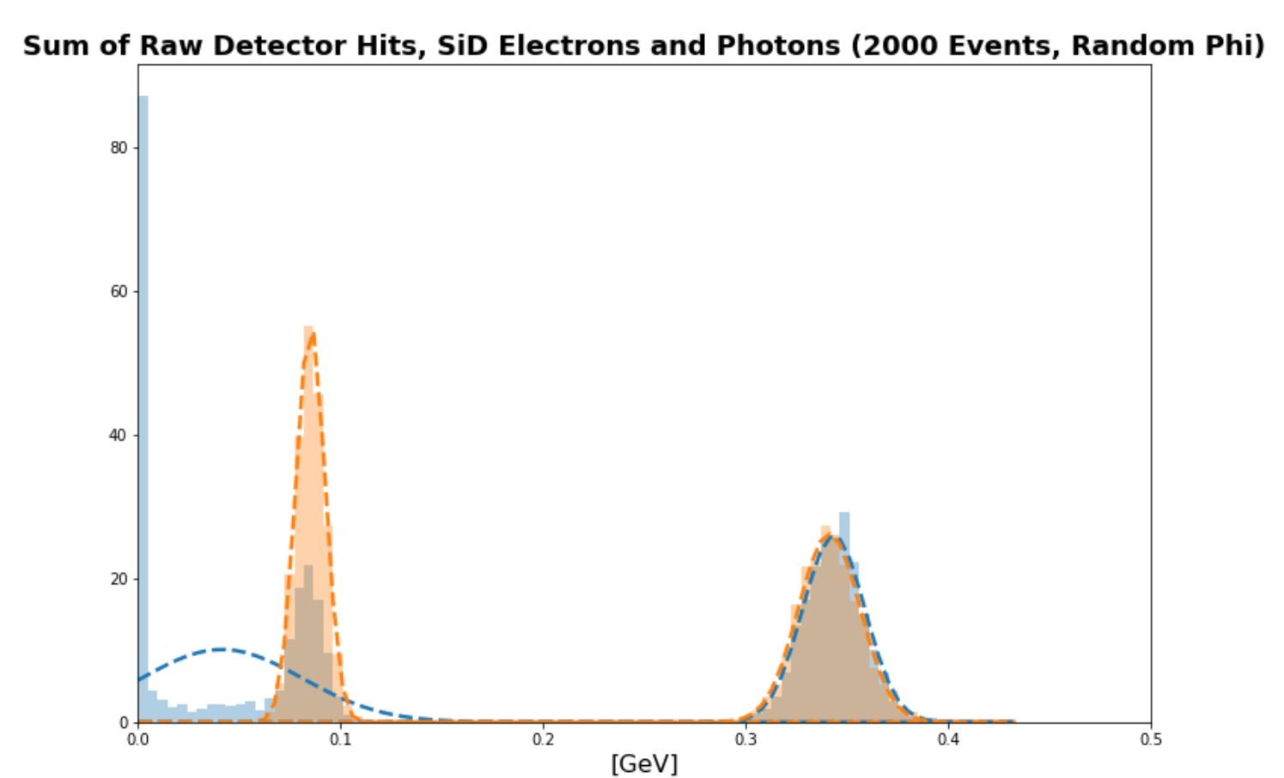
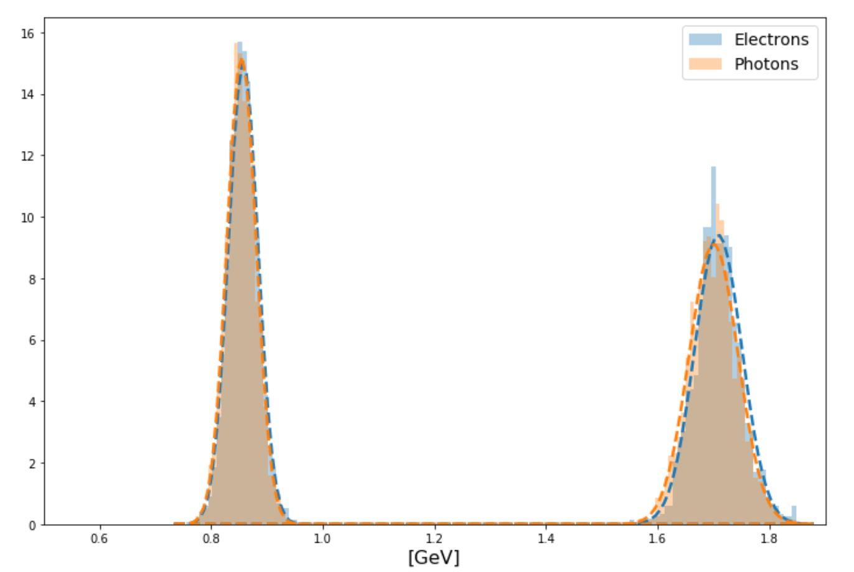
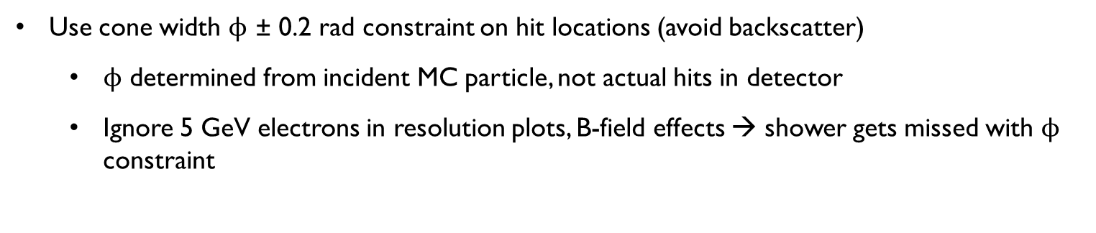
Distrubutions
50 GeV
5 GeV
100 GeV
10 GeV
Use cone width $ϕ$ ± 0.2 rad constraint on hit locations (avoid backscatter)
$ϕ$ determined from incident MC particle, not actual hits in detector
Ignore 5 GeV electrons in resolution plots, B-field effects → shower gets missed with $ϕ$ constraint

Slide 15
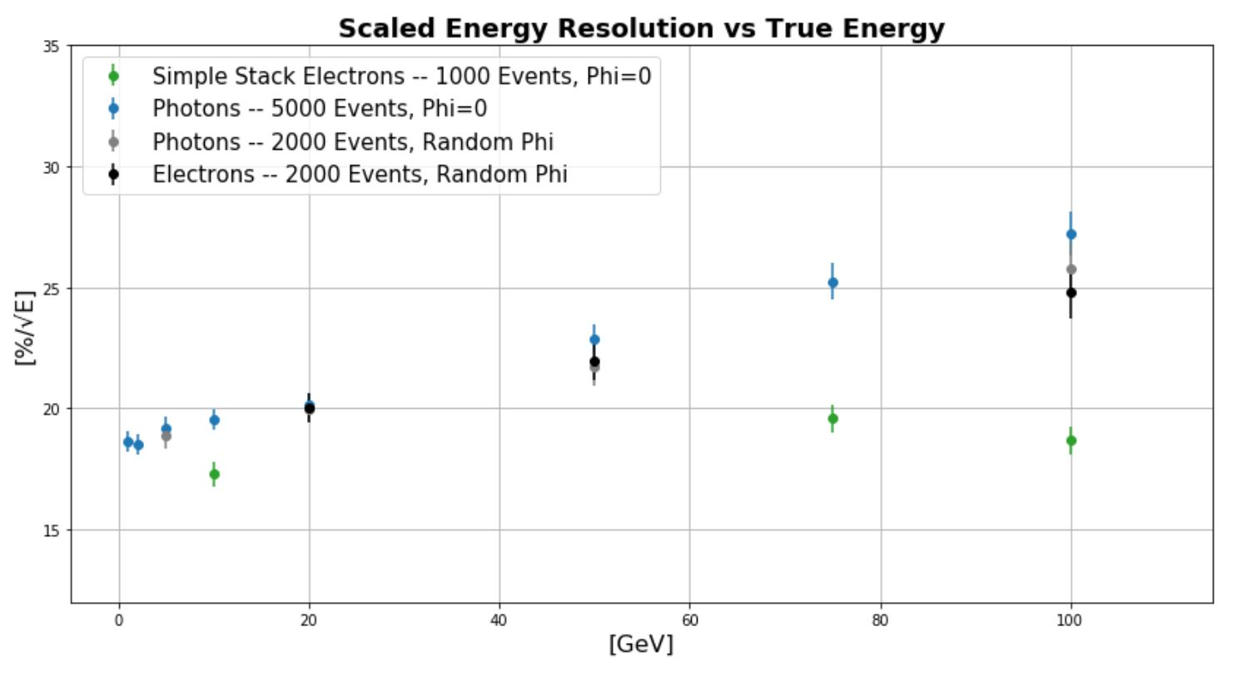
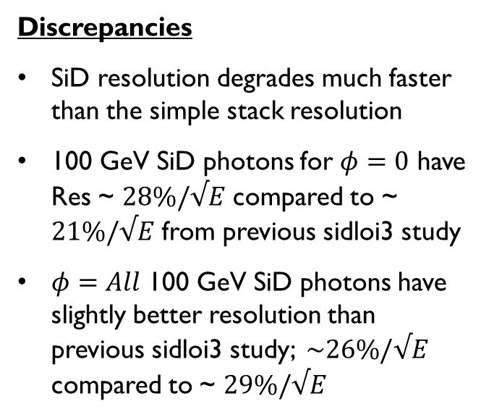
Comparisons
Discrepancies
SiD resolution degrades much faster than the simple stack resolution
100 GeV SiD photons for $φ=0$ have Res ~ $28\%/√E$ compared to ~ $21\%/√E$ from previous sidloi3 study
$φ=All$ 100 GeV SiD photons have slightly better resolution than previous sidloi3 study; $\sim 26\%/√E$ compared to ~ $29\%/√E$

Slide 16
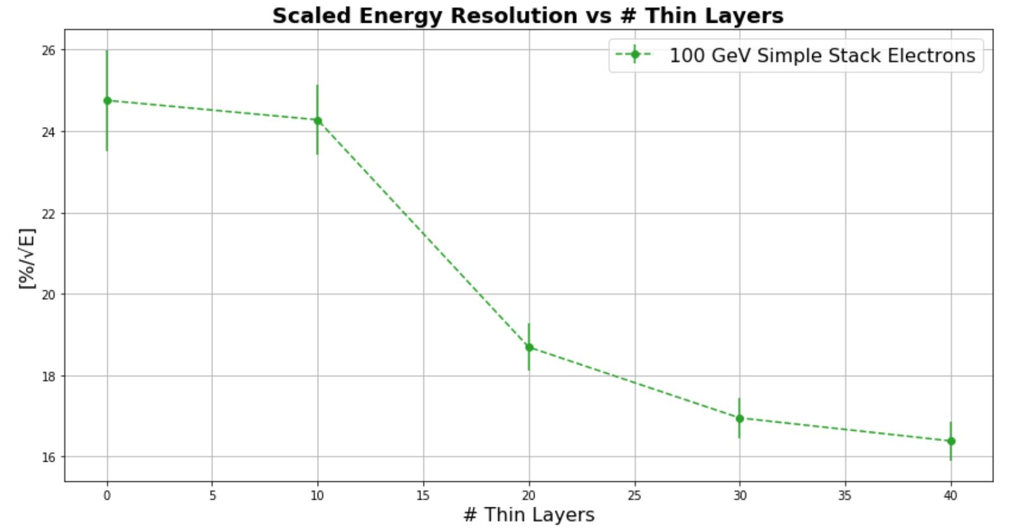
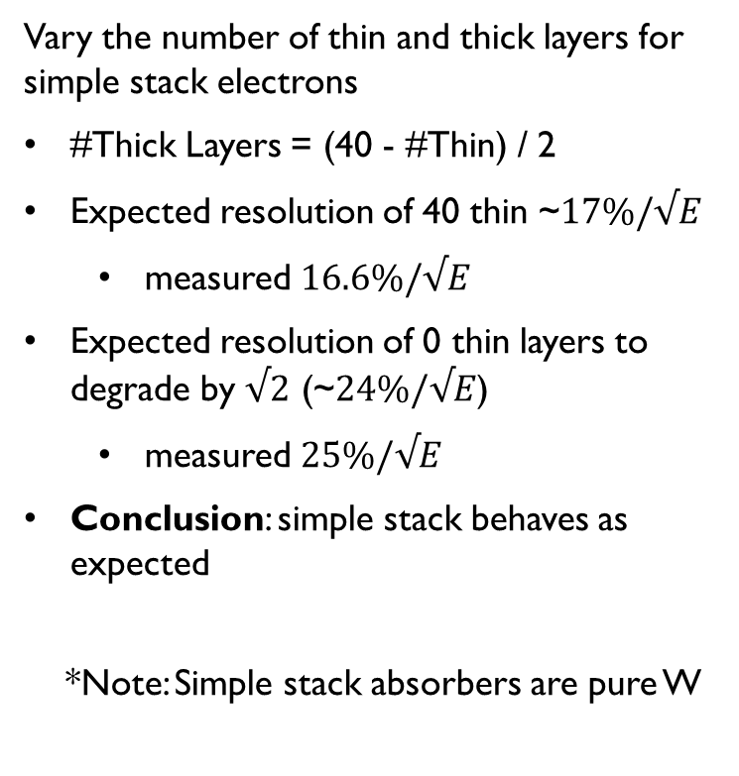
Confirm simple stack behaves as expected
Vary the number of thin and thick layers for simple stack electrons
#Thick Layers = (40 - #Thin) / 2
Expected resolution of 40 thin ~$17\%/√E$
measured $16.6\%/√E$
Expected resolution of 0 thin layers to degrade by $√2$ (~$24\%/√E$)
measured $25\%/√E$
Conclusion: simple stack behaves as expected
*Note: Simple stack absorbers are pure W

Slide 17
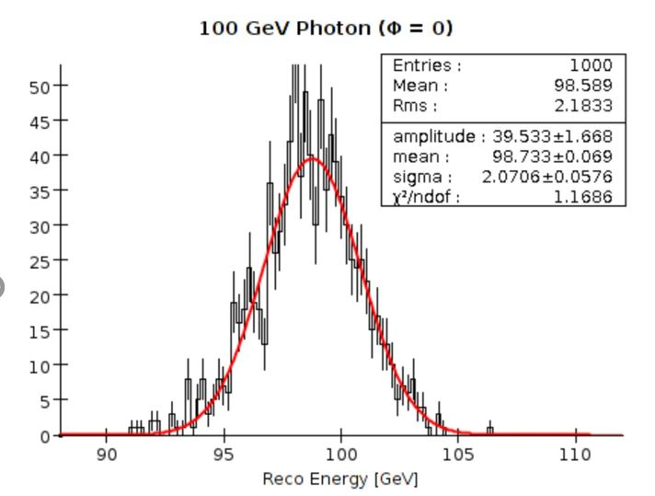
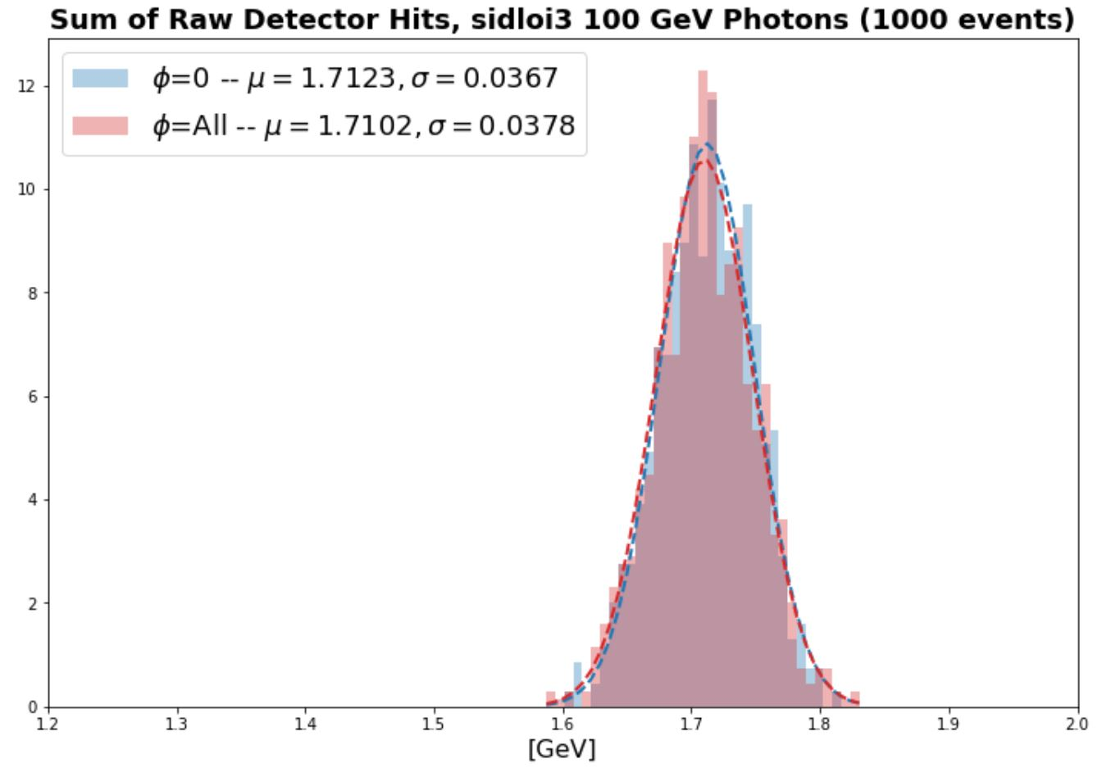
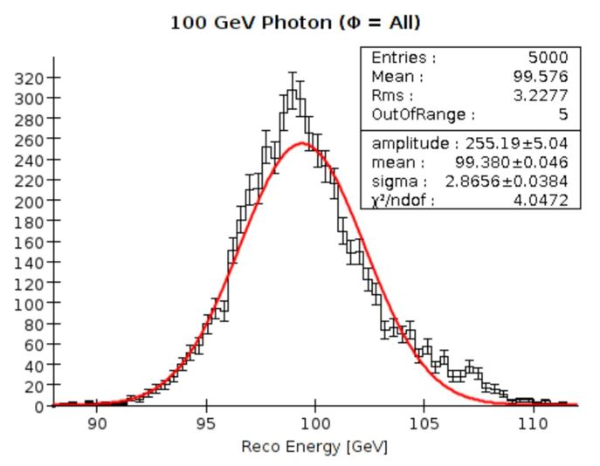
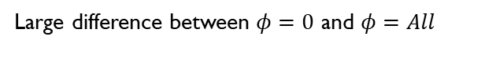
sidloi3 results
Previous study
(Da An, et al.)
Current study →
(what is used on following resolution plot)
Small/negligible difference between $φ=0$ and $φ=All$
Large difference between $φ=0$ and $φ=All$

Slide 18
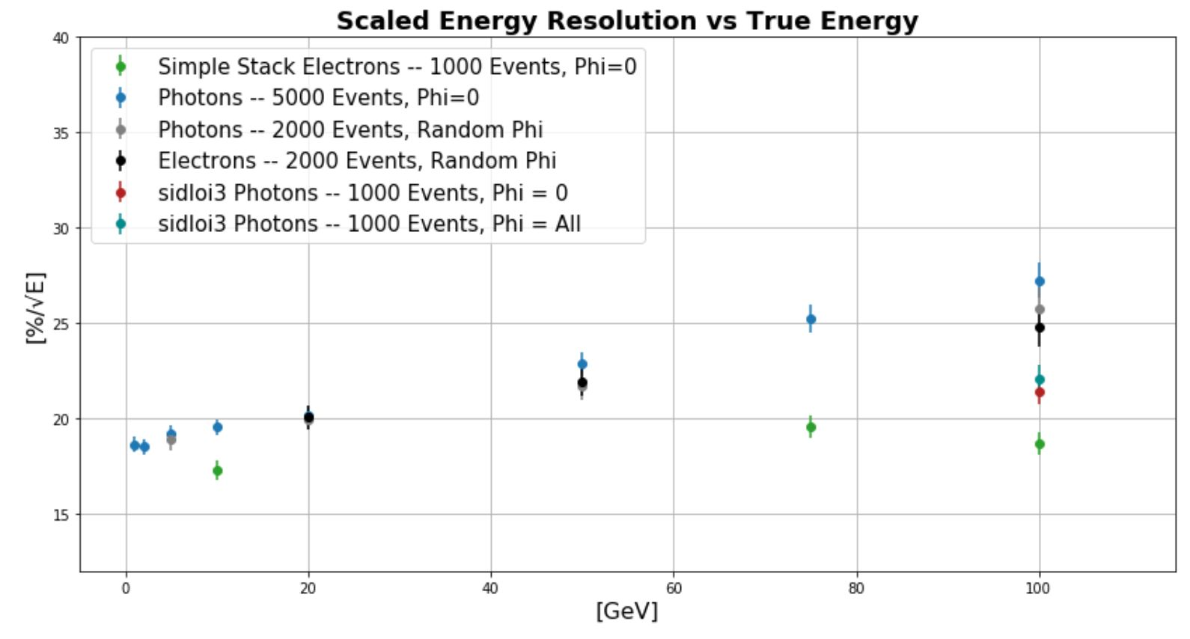
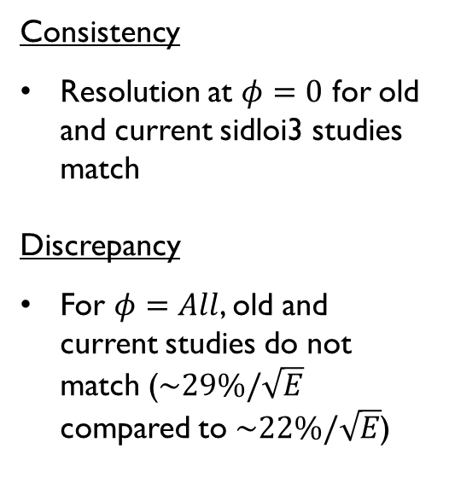
SIDloi3 Results (cont.)
Consistency
Resolution at $φ=0$ for old and current sidloi3 studies match
Discrepancy
For $φ=All$, old and current studies do not match ($\sim 29\%/\sqrt{E}$ compared to $\sim 22\%/\sqrt{E}$)

Slide 19
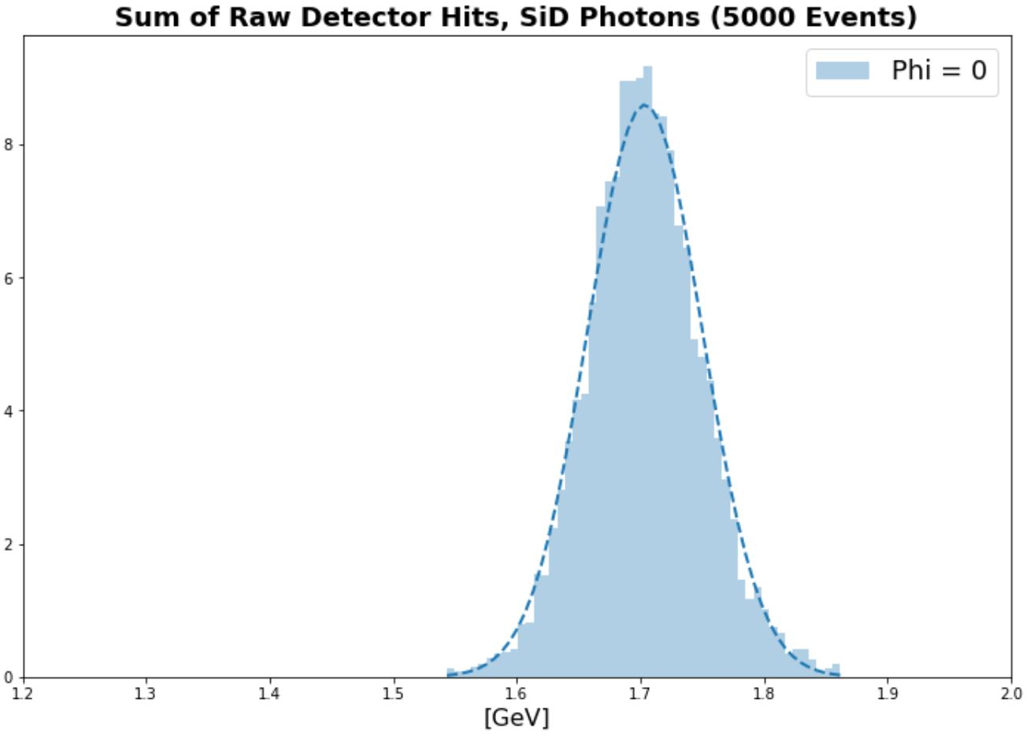
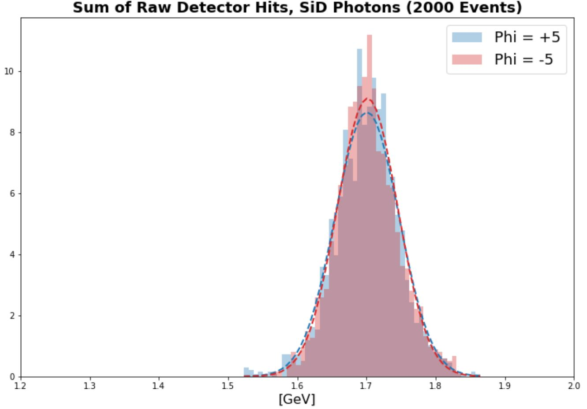
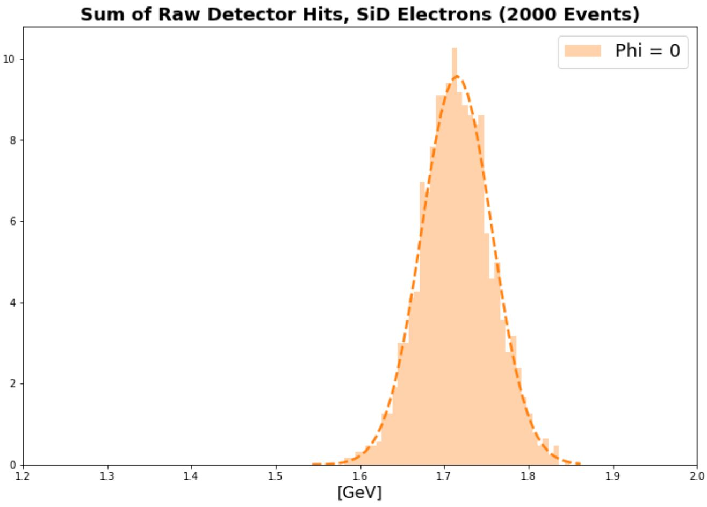
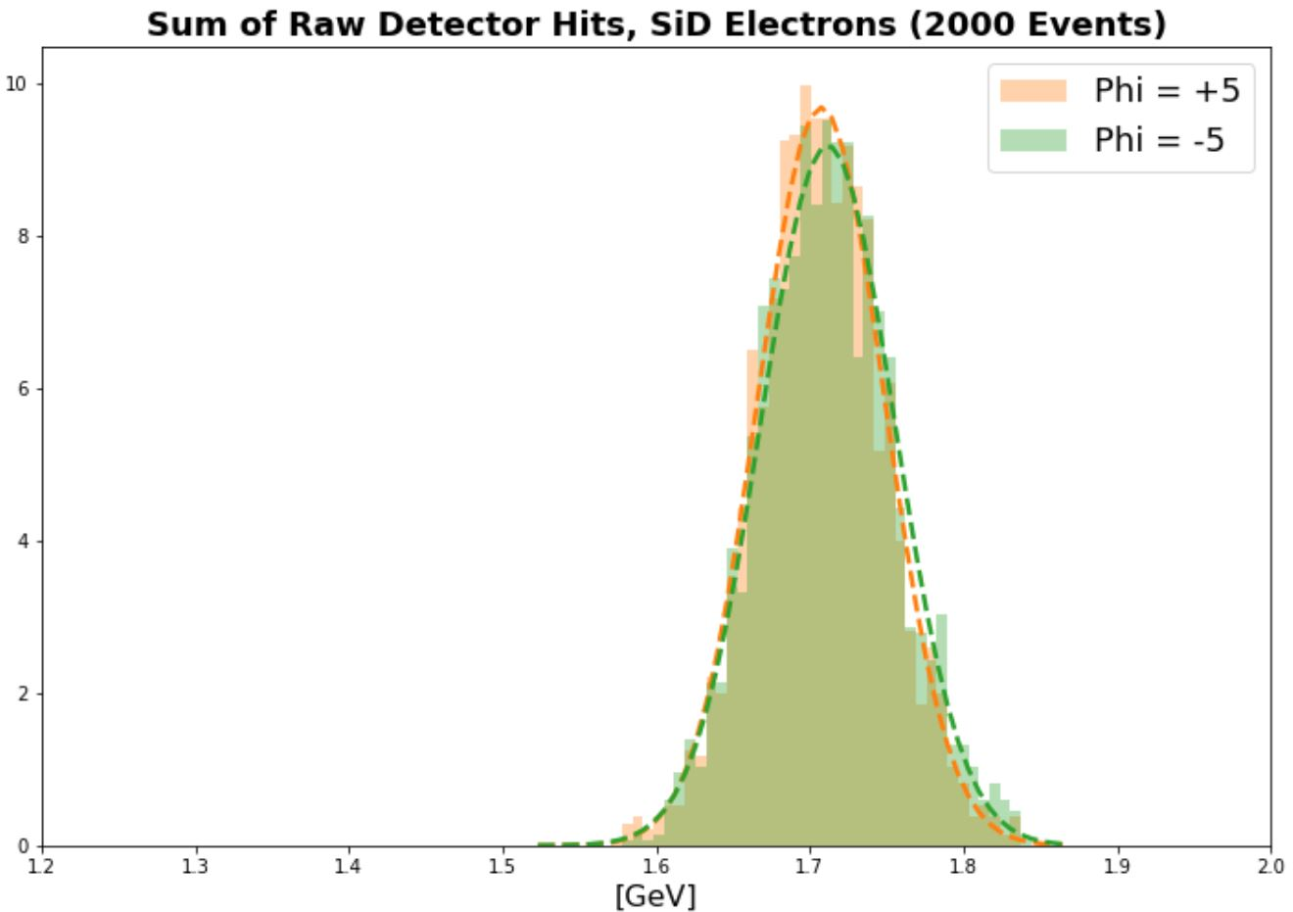
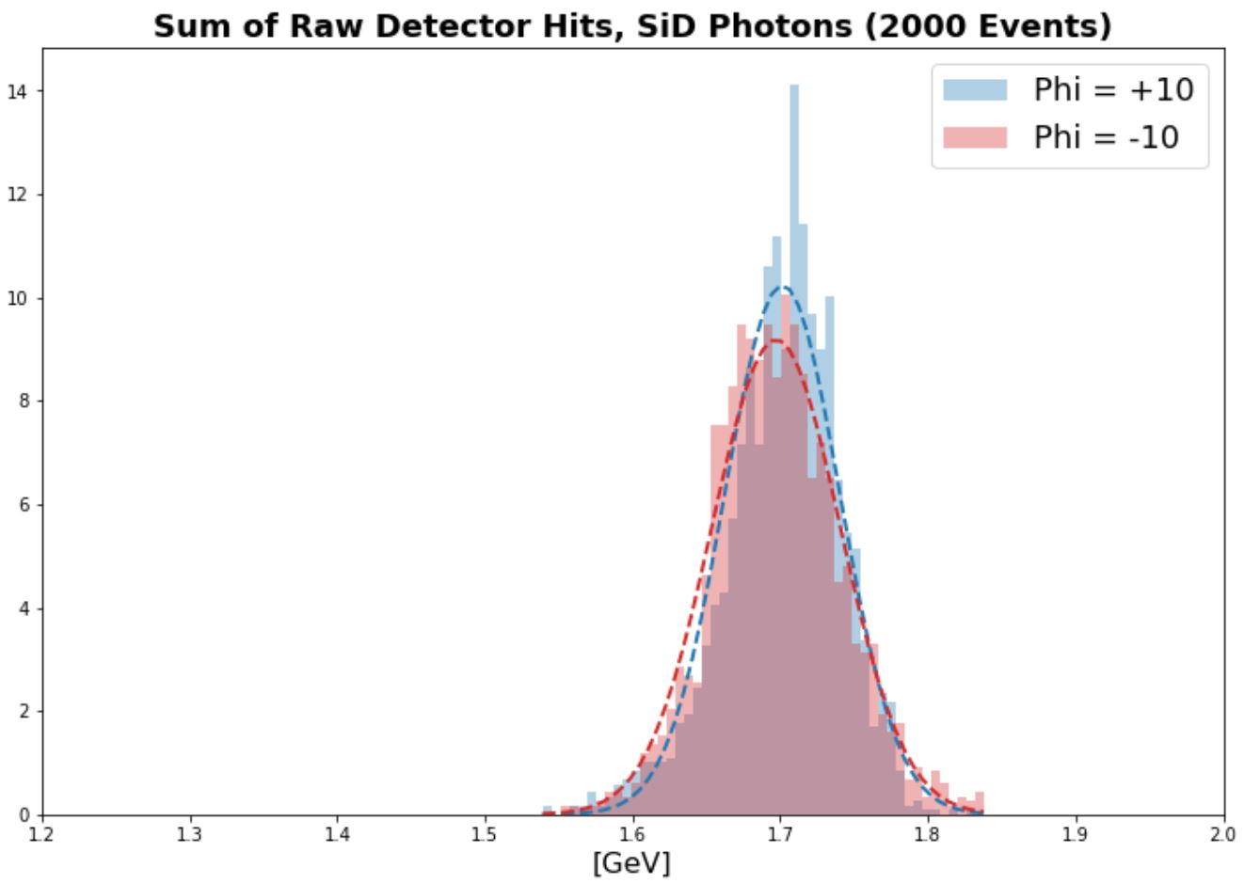
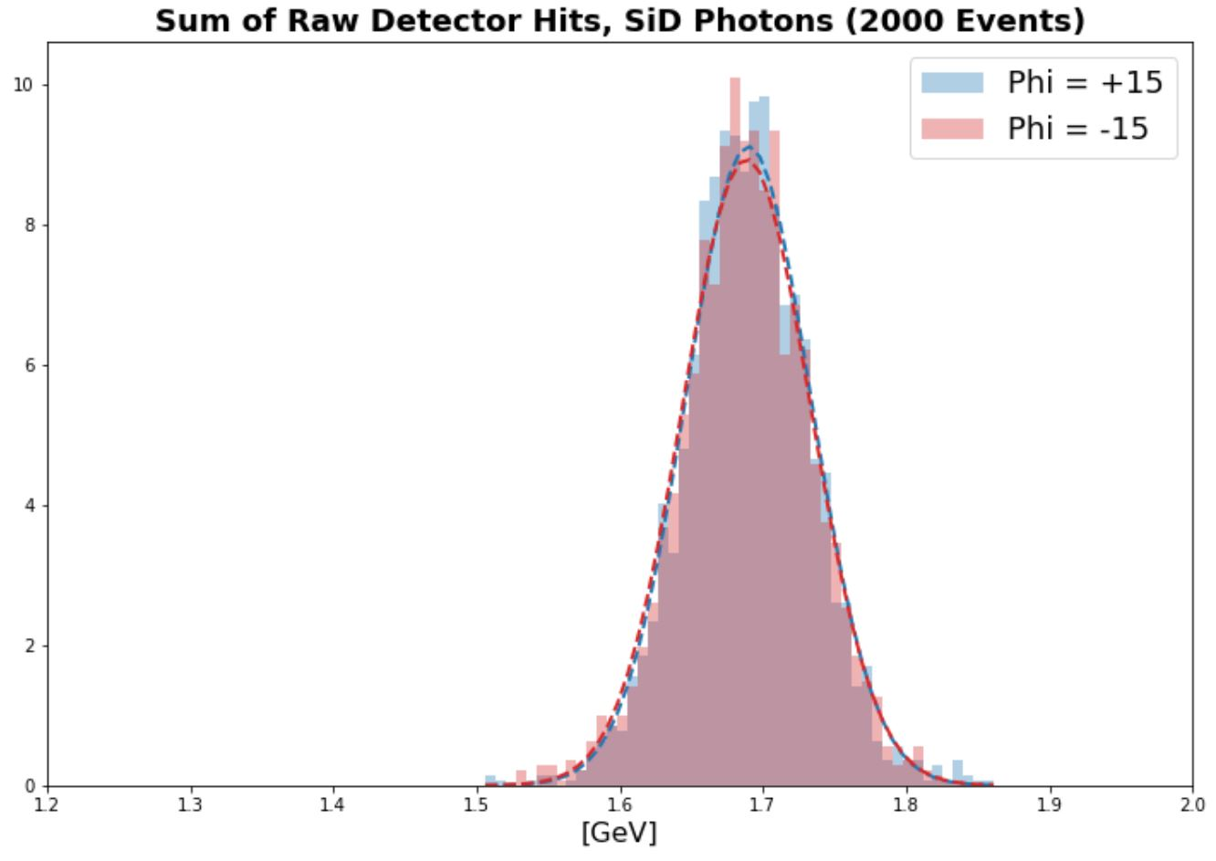
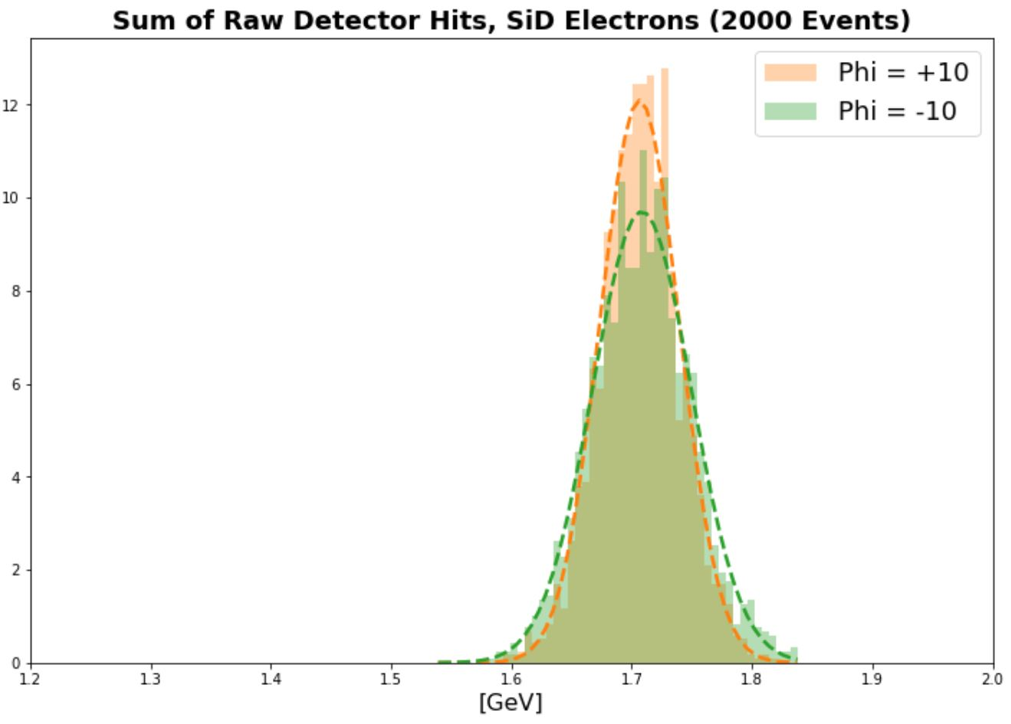
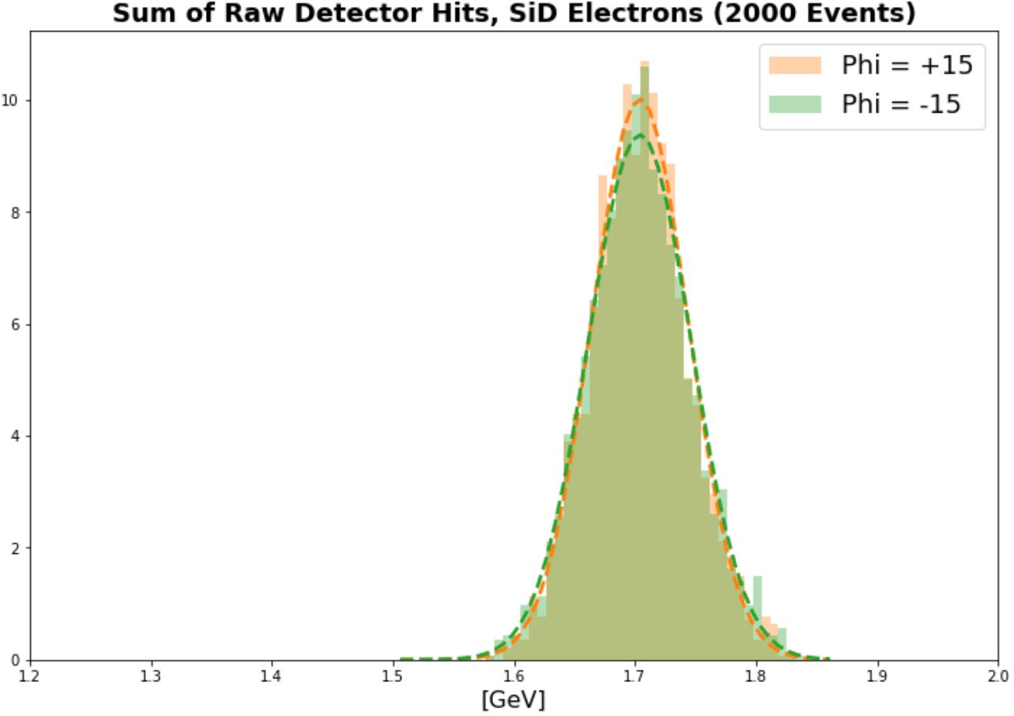
How does incident hit location in module affect resolution?

Slide 20
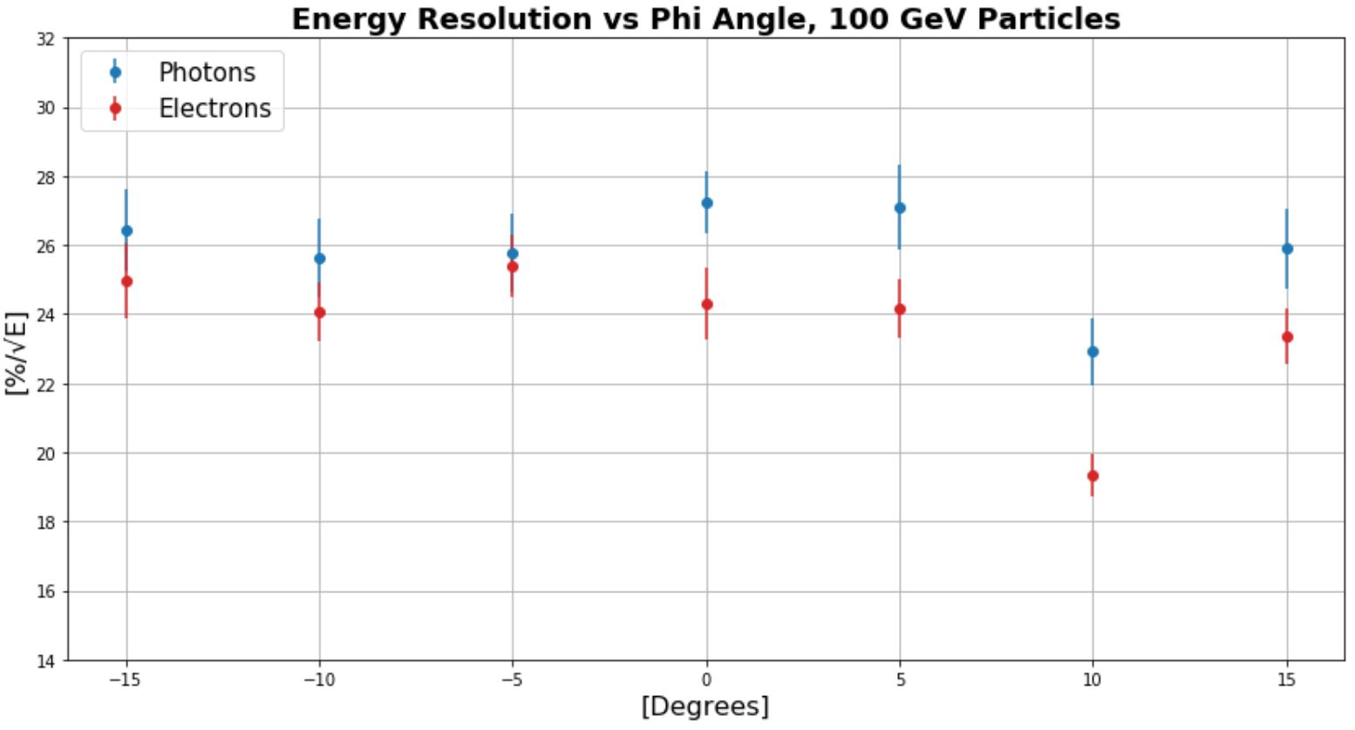
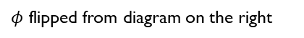

Resolution Dependence on phi
Closest overlap region to normal incidence: ~ $−4^{°}$
$φ=10°$ ensures entire shower goes through center of module
100 GeV e- at $φ=10°$ is comparable to simple stack
$φ$ flipped from diagram on the right

Slide 21


Summary of current Resolution results
Current SiD compares better to previous studies when incident particles are fired at $φ=10°$ instead of normal incidence
Shower mostly contained in nonoverlapping region
Next: What about real events?!

Slide 22


Calo hits
Truth MCParticle
Electron/Positron
Pandora PFOs

Slide 23


Investigation of photon-photon opening angle
Raw Data
Truth Info
Pandora PFOs

Slide 24


Truth Energy Resolution around True Rho
Choosing a certain percent of the rho energy and looking at the percent of events that contain that amount of the rho energy vs. the cone angle.
0.05rad → ~6cm
~<20 pixel widths
Choosing a certain cone angle and looking at the cumulative distribution for how many events get to a certain percent of the rho energy shown on the x-axis.

Slide 25
Summary
Better understanding current results more every day
Resolution differences from initial design resolution to current design geometry
Comparison between versions of geometry can be tricky
Initial π⁰→γγ resolution studies underway

Slide 26
Backup

Slide 27

W-First vs Si-First simulation
Distribution of energies in simulation depending on which way the test beam was facing into the detector, small differences

Slide 28


Slide 29


Slide 30


BackScatter

